Slide 1
Report 3
Parking Guidance System Solution

Slide 2
Table of Contents
User Requirement Specification
System Requirement Specification
Software System Attribute
Conceptual Diagram

Slide 3

Project name: Parking Guidance System Solution
Vietnamese name: Giải pháp hệ thống chỉ dẫn đỗ xe
Abbreviation: PGSS
Product Type: Internet of Things Application
Start Date: 3-Jan-2017

Slide 4
User Requirement Specification

Slide 5
Parking Guidance System Requirement
PGSS detect state of parking slot and update to server.
Mobile App Requirement
Mobile app provide function that user can use:
Search for parking areas.
Reserve a parking slot.

Slide 6
System Requirement Specification

Slide 7
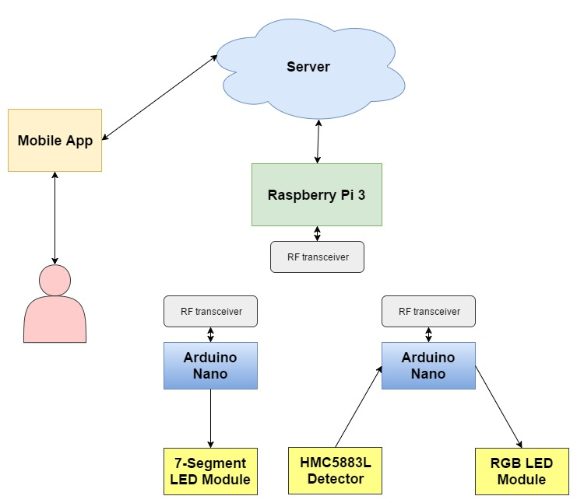
Block Diagram

Slide 8
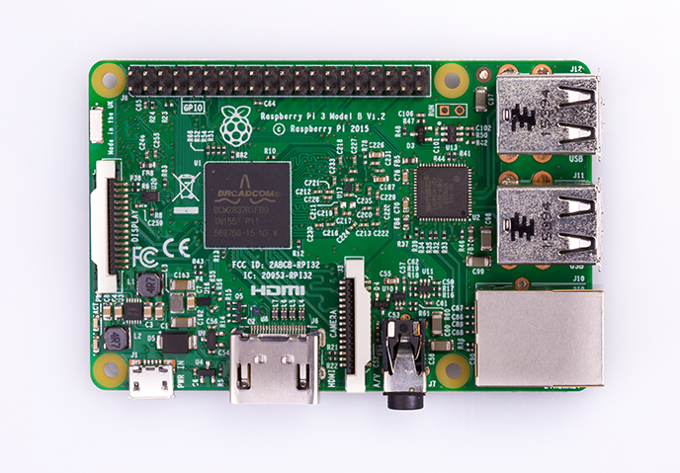
Hardware
1GB RAM
4 USB ports
40 GPIO pins
Full HDMI port
Ethernet port
Combined 3.5mm audio jack and composite video
Camera interface (CSI)
Display interface (DSI)
Micro SD card slot (now push-pull rather than push-push)
VideoCore IV 3D graphics core
Raspberry Pi 3

Slide 9
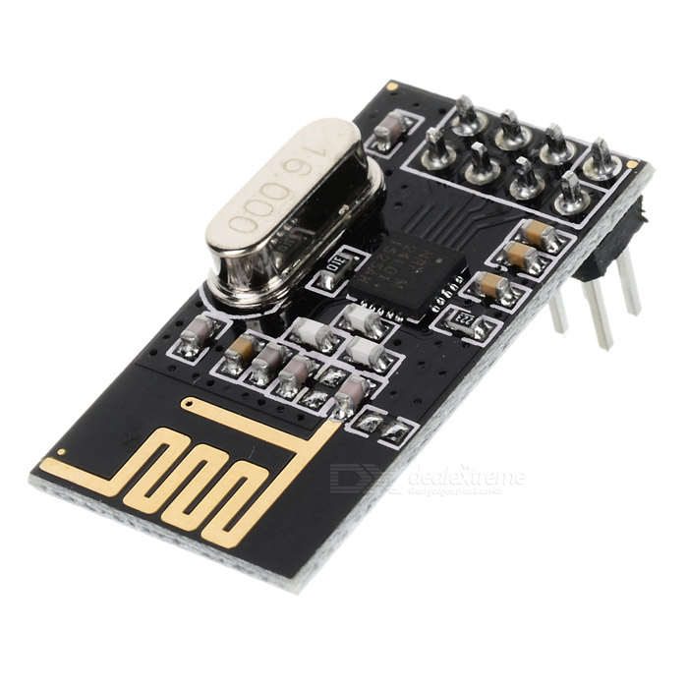
Hardware
Low cost single-chip 2.4GHz RF transceiver IC
Ultra low power consumption – months to years of battery lifetime
Easy to buy
NRF24L01 Transceiver Module

Slide 10
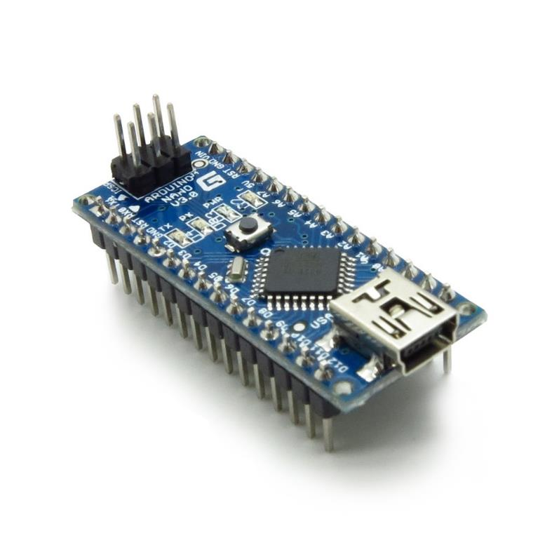
Hardware
The Arduino Nano is a small, complete, and breadboard-friendly board based on the ATmega328
Arduino Nano

Slide 11
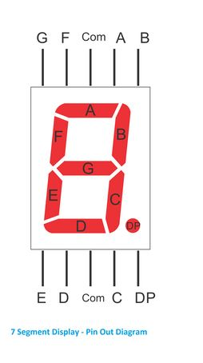
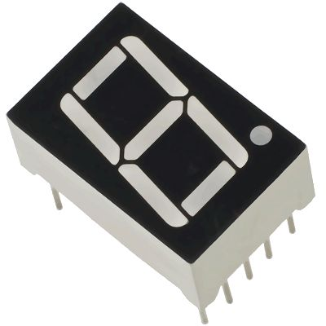
Hardware
7-segment LED

Slide 12
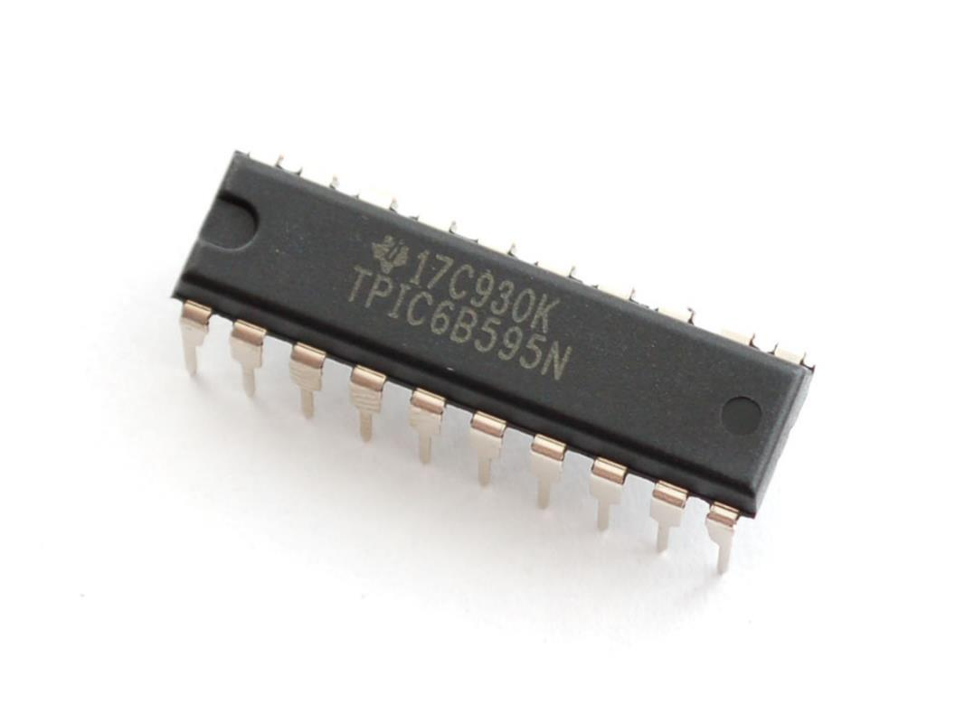
Hardware
High-voltage, medium-current power 8-bit shift register designed for use in systems that require relatively high load power.
Current for each output 150mA.
Low-Power Consumption.
TPIC6B595 Power Logic 8-Bit Shift Register

Slide 13
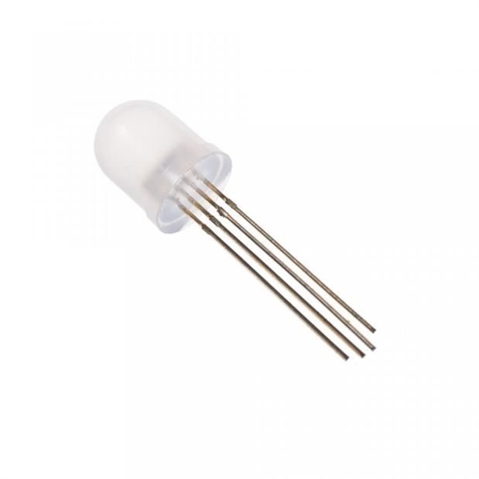
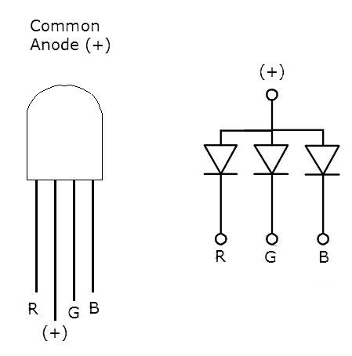
Hardware
RGB LED
RGB LED Pins

Slide 14
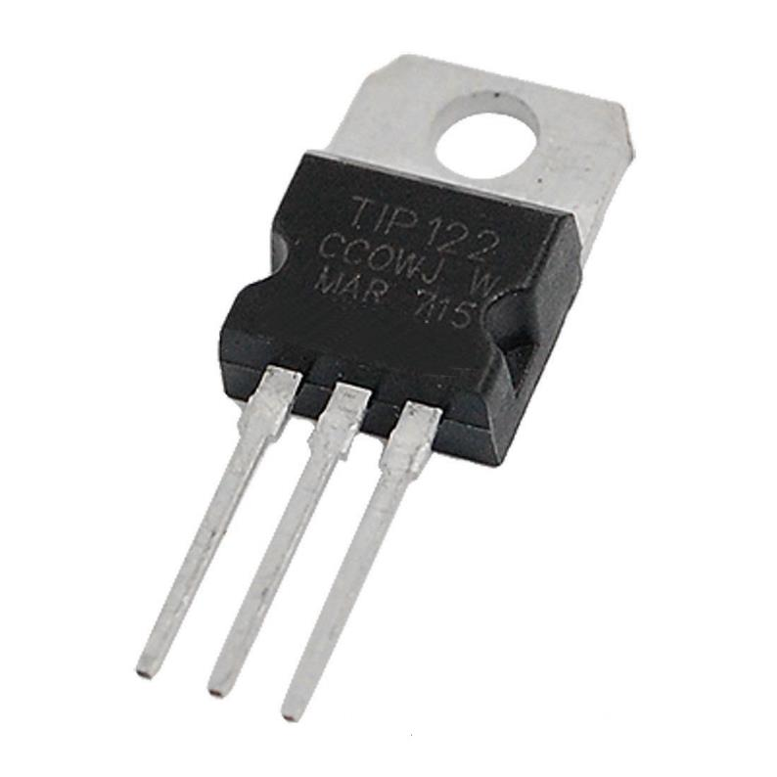
Hardware
TIP122 is power transistors
Collector Current: 5 ampere
Collector-Emitter Volt: 100 volts
Power Dissipation: 65 watts
TIP122 Transistor

Slide 15
Use Case

Slide 16
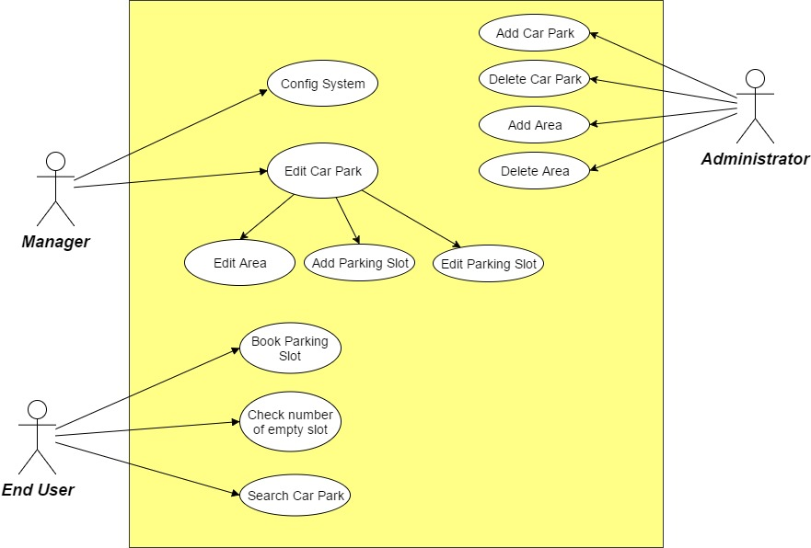
System Overview Use Case

Slide 17
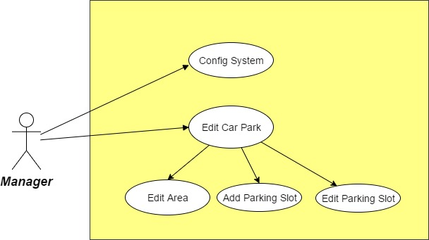
Manager Use Case

Slide 18
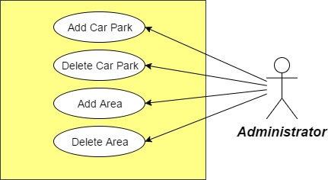
Administrator Use Case

Slide 19
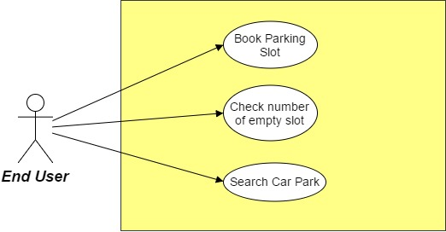
End User Use Case

Slide 20
Software System Attribute

Slide 21
Usability
User controls all system components via only mobile application.
The system can install easily.
User can learn how to use the system fast.
Availability
The mechanical component require electrical system to work well.
Hardware components are easy to find in the market.
Security
Mobile application require authentication and authorization implement well because manager and end user use the same application.

Slide 22
Maintainability
Use plug and play component so we can easily replace it.
Portability
Easy to construct.
Performance
Detection car is fast, less then 50ms.
The speed of server can scale base on the budget easily.

Slide 23
Conceptual Diagram

Slide 24
Figure 1: Boundaries of the system

